Slide 1

OBJECT-ORIENTED DESIGN IN SMART HEALTHCARE SYSTEMS
CSA1104-OBJECT ORIENTED ANALYSIS AND DESIGN
BY: K.Divya
192511316
FACULTY: Dr. A Gayathri

Slide 2
INTRODUCTION
What is Object-Oriented Design (OOD)?
OOD is a software design approach based on objects and classes.
It Smart Healthcare Systems use OOD to organize patient, doctor, and medical information efficiently.
It improves software quality, maintenance, and scalability.
Key Technologies
Class Object Encapsulation
Inheritance Polymorphism

Slide 3
PROBLEM STATEMENT
Manual and fragmented healthcare systems reduce efficiency.
Difficult to manage patients, doctors, appointments, and medical records.
Poor scalability and software maintenance.
Need a modular, reusable, and secure Object-Oriented Design for smart healthcare systems.

Slide 4
OBJECTIVES
Design a Smart Healthcare System using Object-Oriented Design (OOD) principles.
Model real-world healthcare entities such as Patient, Doctor, Appointment, and Medical Record as objects and classes.
Improve software modularity, reusability, and maintainability through object-oriented concepts.
Ensure secure and efficient management of patient information using encapsulation.

Slide 5
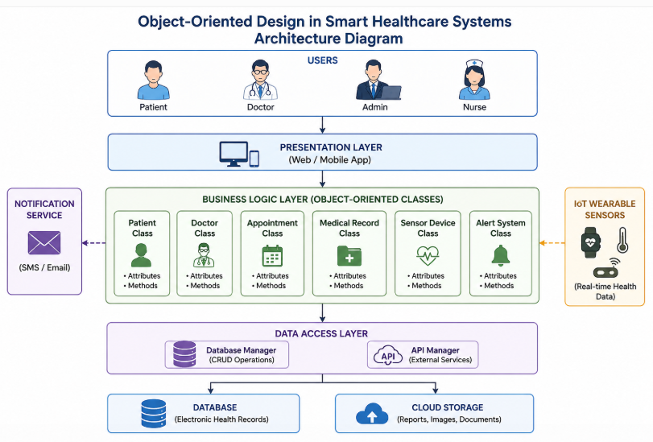
SYSTEM ARCHITECTURE

Slide 6
OOD COMPONENTS IN SMART HEALTHCARE MAIN CLASSES
Class | Responsibility
Patient | Stores patient details and medical history
Doctor | Manages diagnosis and treatment
Appointment | Schedules patient visits
Medical Record | Maintains health records
Sensor Device | Collects real-time health data
Alert System | Sends emergency notifications

Slide 7
ADVANTAGES
Improved patient management
Easy maintenance
Modular design
Secure data handling
Reusable software components
Scalable healthcare systems

Slide 8
Applications
Hospital Management Systems
Telemedicine
Electronic Health Records (EHR)
Remote Patient Monitoring
Health Monitoring Wearables

Slide 9
CONCLUSION:
Object-Oriented Design provides a structured way to develop healthcare software.
It improves reliability, flexibility, and maintainability.
Smart Healthcare Systems become more efficient with reusable and secure object-oriented components.
OOD supports future technologies such as AI, IoT, and cloud-based healthcare.

Slide 10
Thank
you✨

